Slide 1

Software Engineering Summit
Android Workshop
Instructor: Yashar Atajan
TA: Nick Capurso

Slide 2







About Yashar
Yashar Atajan @yaxarat
Undergrad - Virginia Commonwealth University
Software Engineer working on Android SDKs.

Slide 3






About Nick
Nick Capurso @nickcapurso
Undergrad - Texas Christian Univ (TCU) Grad - George Washington Univ (GWU) I also teach Android at GWU! Capital One Wallet, Capital One Mobile, SDKs
Came in through the intern & TDP programs :)

Slide 4
Before we get started...
We’ll be using this GitHub repo as a base.
The workshop assumes you completed the pre-reqs and have a working Android development environment.
Ability to run the app on the Android emulator or a physical device.
Import the “Start” folder into Android Studio and run it on an emulator / device.

Slide 5
If you need help...
Short questions:
Use the “Raise Hand” action in Zoom. Or feel free to speak out!
You can also post short questions in the Zoom chat - we’ll be monitoring it!
Debugging help:
Post your issue in the #ses-may21help-xg Slack channel with any relevant code / screenshots.
During short breaks in the workshop, we will use Zoom breakout rooms for any in-depth debugging with screen share.
Slack: @yashar (Instructor), @nickcapurso (TA)
Step-by-step instructions:
Full text instructions for this workshop are available on GitHub.

Slide 6
Workshop

Slide 7
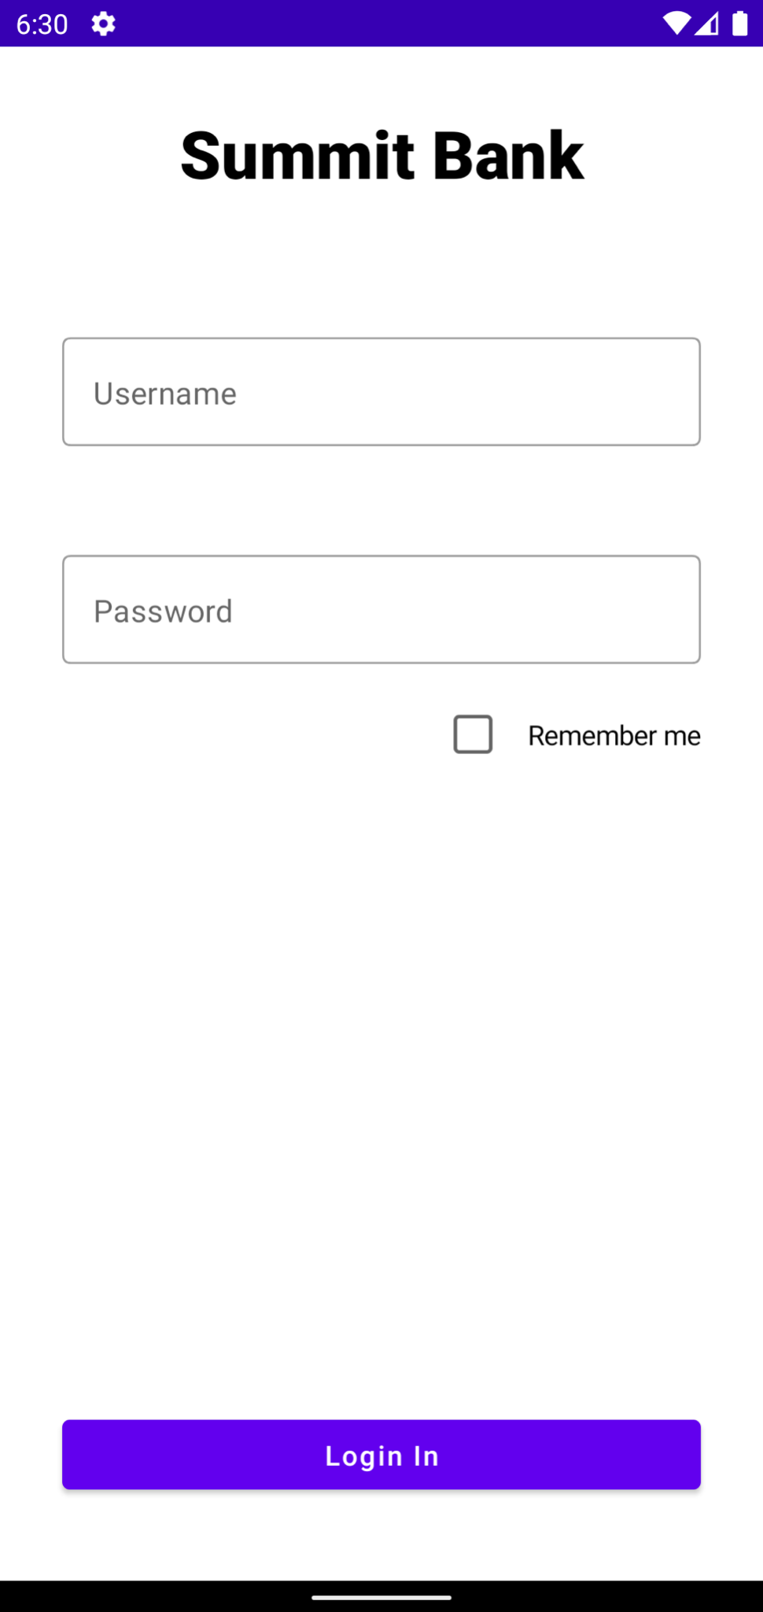
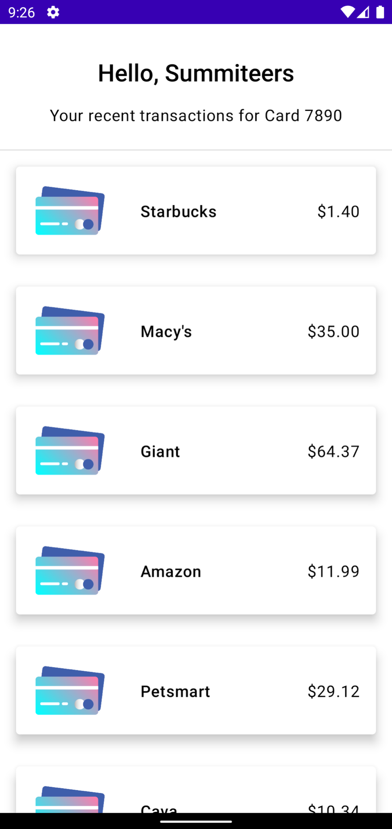
What’re we building?
A simple app that allows the user to login & view a list of recent transactions.

Slide 8
What’re we building?
Topics
UI Design
Launching new screens
Networking (mocked)
Extra
Data Persistence
Processing events on list items

Slide 9
Android Studio
Some Android Studio configurations to make the workshop go more smoothly…

Slide 10
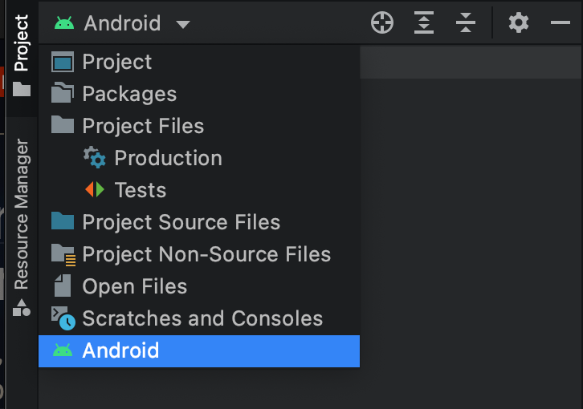
Android Studio
In the left-panel, switch to the “Android” view.
I prefer this view of the project files as I think it is more concise and easy to navigate.
Click Android if not pre-set.

Slide 11
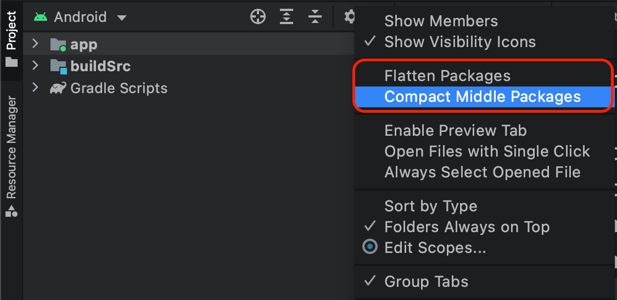
Android Studio
Open Settings / Preferences
(Windows) File → Settings
(OS X) Android Studio → Preferences
Turn on auto-imports!
Under: Editor → General → Auto Import
Enable “Add unambiguous imports…”
Enable “Optimize imports…”
Do not flatten packages!
Under three dotted settings, uncheck “Flatten / Compact middle packages”

Slide 12
Fragments
Apps are comprised of “Fragments” that live inside an “Activity”.
You can think of these as the individual screens.
Notes:
You can further break down into Fragments which is an encapsulation of UI + behaviors (but are less beginner-friendly)

Slide 13
Fragments
Two main components:
UI design
What does the UI look like
UI behaviors
How does the UI react to user input

Slide 14
UI Design

Slide 15
UI Design
UIs are built with a Jetpack Compose framework.

Slide 16
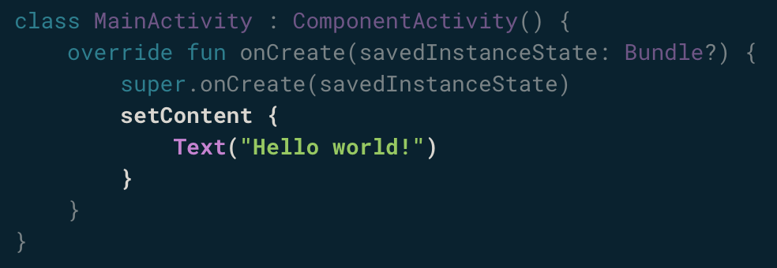
UI Design
Jetpack Compose is built around composable functions.
These functions let you define your app's UI programmatically.
Composable functions can only be called from within other composable functions.

Slide 17
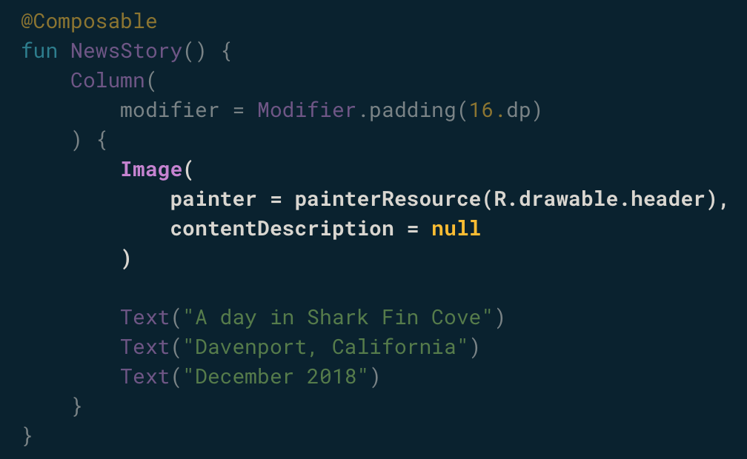
UI Design
UI elements are hierarchical, with elements contained in other elements.
You build a UI hierarchy by nesting composable functions.

Slide 18
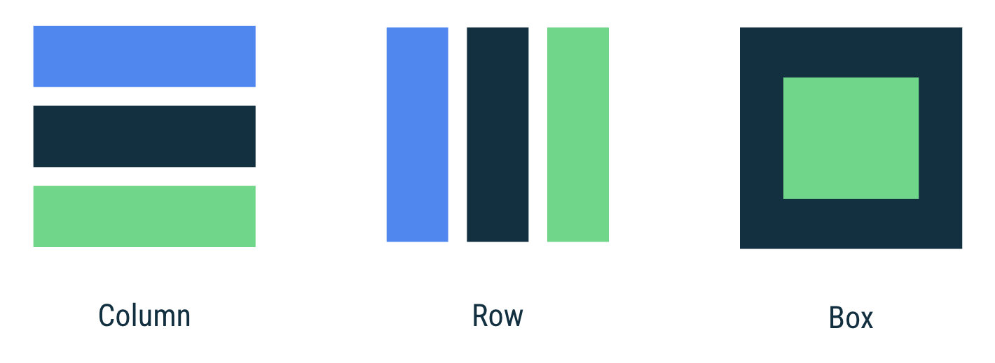
UI Layouts
Column: to place items vertically on the screen.
Row: to place items horizontally on the screen.
Box: to put one element on top of another.

Slide 19

UI Layouts
On Android, we don’t measure in pixels.
Two screens of the same size can have different densities.
Android provides “dp” or density-independent pixels as a measure.

Slide 20
UI Layouts
There’s also “sp” or scalable pixels, which are used with text.
This scales with device font size setting.

Slide 21
UI Layouts
Android coordinate system starts from top left and extends to bottom right.
Default position of all UI is at top left edge of (0,0)

Slide 22
Login Screen UI
Let’s build a simple login form, without the “Remember Me” checkbox.

Slide 23
State
State is at the core of compose
Textfield did not update since state was not updated
State can be stored and updated using mutableState
UI updating for an updated state is called “recomposition”

Slide 24
UI Behaviors

Slide 25
Login Screen Behaviors
Now we can actually write some code to add behaviors to the UI.
Disable the “Sign In” button unless text was inputted.
Show loading indicator while login

Slide 26
Login Screen Behaviors
Android apps use an “event-driven” programming style.
Rather than having a main() function and executing sequentially, we write code that responds to events.
e.g. when the screen loads, when the user performs some input, etc.

Slide 27
Login Screen Behaviors
As an Android developer, you may want to react when:
When the screen is created
When the user puts the app in the background
When a popup is obscuring your screen
etc.

Slide 28
Login Screen Behaviors
Android notifies your Activity and Fragment of these events via callbacks:
onCreate
onStart
onStop
etc.
This is called the “lifecycle”!

Slide 29
Login Screen Behaviors
The framework may decide to destroy or re-create a UI in response to certain user actions or device events that are completely out of your control. One such example is device screen rotation (a.k.a configuration change).

Slide 30
Networking

Slide 31
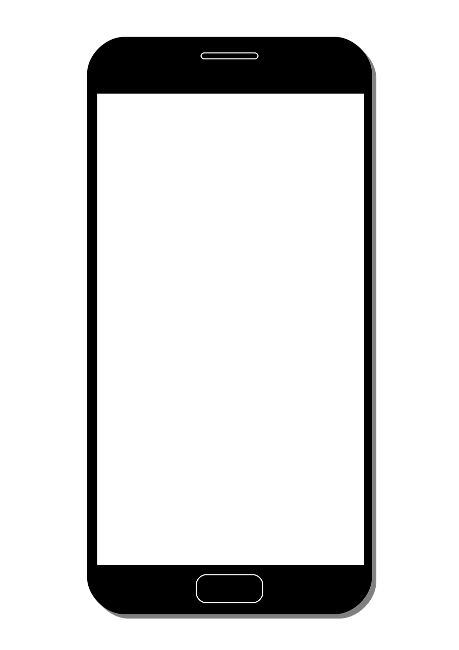

Networking
Usually, signing in involves making a network call.
Server will validate credentials and return user data.
username : summituser01 password : abc123

Slide 32
Networking
Usually, signing in involves making a network call.
Server will validate credentials and return user data.
name : John Summiteer card : x1234 transactions : [ “Starbucks $1.50” … “ ]

Slide 33
Networking
Networking can be a complex subject in Android.
Need to be on a background thread.
Handling connection errors.
Creating a network request.
Parsing a network response.

Slide 34
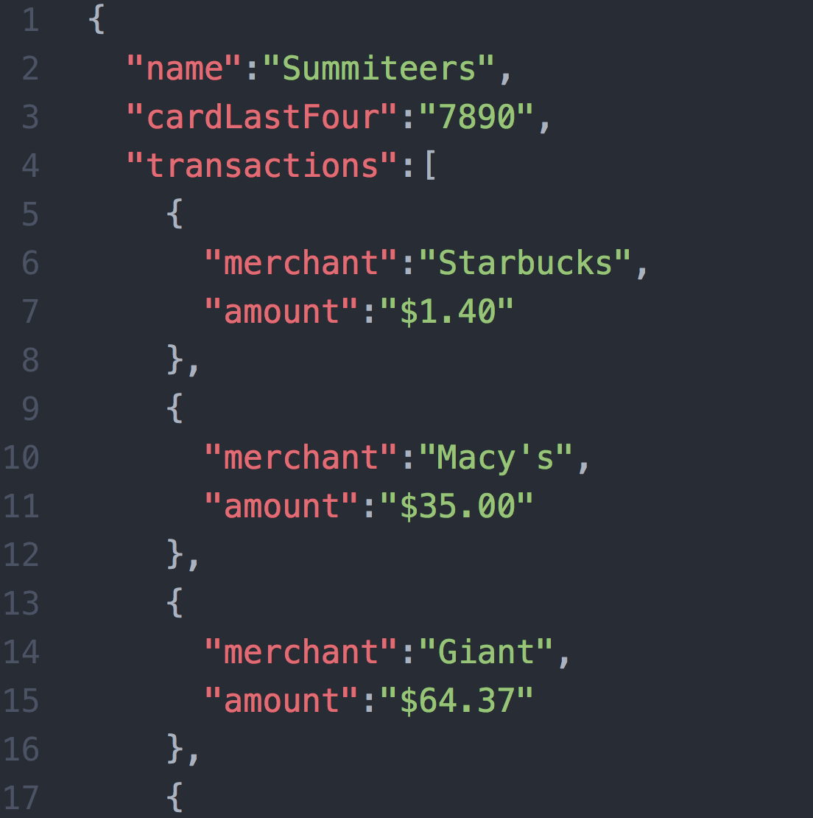
Networking
The server sends back data using some standardized format.
JavaScript Object Notation (JSON) is fairly common.
You’d also need to code to parse the data you need from the server response.

Slide 35
Networking
For the purpose of the workshop let’s use a prebuilt “LoginService” class to retrieve user details after they click the “Sign In” button…
User’s name (“Summiteers”)
User’s card last 4 (“7890”)
List of transactions (“Starbucks $1.50, Amazon $32.10, …)

Slide 36
Second Fragment

Slide 37

We’ll display the user’s data on a separate Fragment called the “SummaryFragment”.
We need to create this new Fragment and launch it from our LoginFragment (passing it the data returned by the server).

Slide 38
Starting a second activity
On login success, we want to start the “SummaryFragment”
We also want to pass the user’s details to that fragment to display.

Slide 39
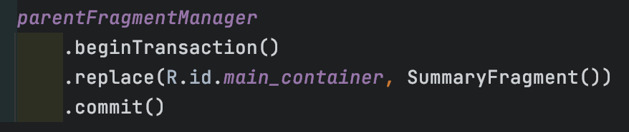
Fragment Transaction
New fragments are launched using “FragmentManager”.
With fragmentManager, you:
Specify which fragment should be launched
How the fragment should be launched
Where the fragment should be launched

Slide 40
Second Fragment
First let’s review what we need to create:
1. A simple text component that we have already created before
2. Same thing, a smaller text component!
3. A divider line component
4. A transaction card component with picture and texts representing that transaction

Slide 41
Fragment Result
You can pass information between fragments using FragmentResult.
It’s a storage for fragments where multiple fragments can use a key to store specific datas.

Slide 42
Extras

Slide 43
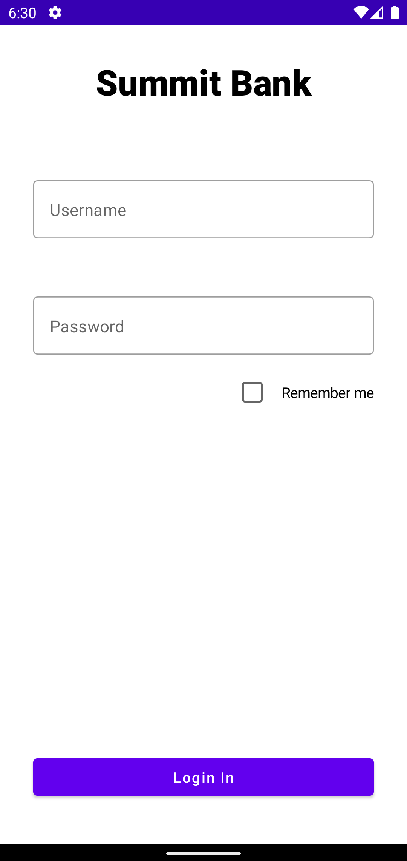
Extra features!
Let’s add on a “Remember Me” feature to remember user credentials.
And also an ability to select each individual transactions.

Slide 44
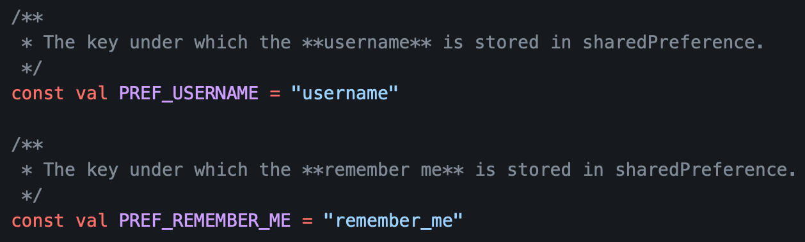
Simple data storage
You can use “SharedPreferences” to store simple key-value pairs to the app’s private storage.

Slide 45
Reacting to list interactions
Let’s also add a simple behavior when the user taps on a transaction.

Slide 46
Wrapping Up

Slide 47
What did we build?
A simple app that allows the user to login & view a list of recent transactions:
Two screens
UI with Jetpack Compose
Basic networking and data storage

Slide 48
What did we build?
If you want the completed project with comments, checkout the “Completed” or “Extra” folder.

Slide 49


Android at Capital One
Over 200 Android (and iOS) devs work on the main Capital One Mobile app alone!
There are other apps built in-house too - like our CreditWise app.
A few devs have Flutter side-projects. Our conference app and website for the Android Summit conference is built in Flutter.

Slide 50
Want to continue learning Android?
Start learning modern Android using Google Codelabs
Android Kotlin Fundamentals
Check out this article in the C1 Tech Blog about helpful resources for learning Android
The Most Helpful Resources From My First Year in Android

Slide 51
Other Resources
“I want to learn more about compose”
https://developer.android.com/jetpack/compose
https://developer.android.com/courses/pathways/compose

Slide 52
Other Resources
“I want to learn more about networking”
Basics: https://developer.android.com/training/basics/network-ops/connecting
Popular libraries for making network calls: http://square.github.io/okhttp/ https://square.github.io/retrofit/
Threading: https://developer.android.com/guide/components/processes-and-threads
JSON parsing: https://www.tutorialspoint.com/android/android_json_parser.htm

Slide 53
Other Resources
“I want to interface with an API”
Capital One’s Hackathon API (Nessie) http://api.reimaginebanking.com/
“Host Your Own” Fake API: https://www.mocky.io/

Slide 54
Other Resources
“I want to use some hardware features”
Camera: https://developer.android.com/guide/topics/media/camera
Sensors: https://developer.android.com/guide/topics/sensors/sensors_overview
Bluetooth: https://developer.android.com/guide/topics/connectivity/bluetooth
NFC: https://developer.android.com/guide/topics/connectivity/nfc/

Slide 55
Other Resources
“I want a backend for user credentials and data”
Firebase Authentication (free): https://firebase.google.com/docs/auth/
Firebase Realtime DB (also free): https://firebase.google.com/docs/database/

Slide 56
Thanks for attending!
Find us on Slack and LinkedIn:
Slack: @yashar
https://www.linkedin.com/in/yaxarat/
Slack: @nickcapurso
https://www.linkedin.com/in/nickcapurso

